Slide 1
CL 304: Chemical Process Technology
DDT: Production, Raw Material and Application
Group - 2
Dev Jyoti 210107023
Dnyanesh Bhole 210107019
Brotish Pal 210107020

Slide 2
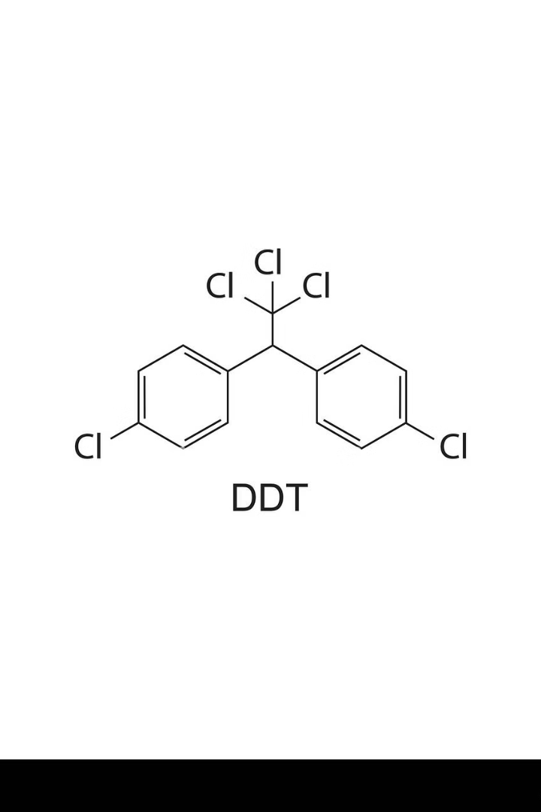
Introduction to DDT
Diphenyl Dichloro Trichloethane, more commonly known as DDT, is a synthetic pesticide that was widely used in the mid-20th century for its effectiveness in controlling insect-borne diseases such as malaria and typhus. Developed in the 1940s, DDT quickly became a valuable tool in public health efforts around the world, playing a crucial role in the eradication of malaria in many regions. However, the widespread and indiscriminate use of DDT also led to growing concerns about its environmental impact and potential health risks, ultimately leading to its ban in many countries in the 1970s.

Slide 3
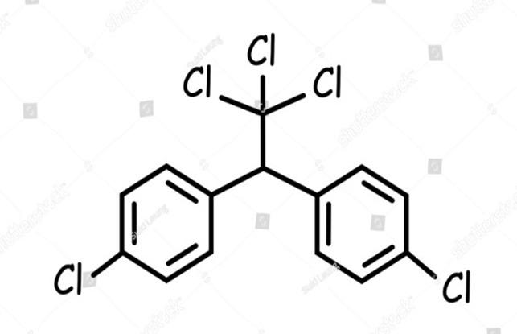
Molecular Structure
Diphenyl Dichloro Trichloroethane (DDT) is an organochlorine compound with the chemical formula C14H9Cl5. The molecule consists of two phenyl rings attached to a central trichloroethane moiety. The two chlorine atoms are positioned at the 4 and 4' positions of the phenyl rings, giving DDT its distinct structure. This arrangement contributes to the compound's stability and lipophilic properties.

Slide 4
Physical Properties
Chemical Stability
DDT is colourless, crystalline solid at room temperature with a slightly sweet odour. It has a melting point of 108-109°C and a boiling point of 260°C. DDT is highly lipophilic, indicating its strong affinity for fatty tissues. This lipophilicity is a key factor in DDT's effectiveness as an insecticide, as it readily penetrates the cuticles and cell membranes of target organisms.
DDT is a remarkably stable compound, resistant to degradation by acids, bases, and oxidising agents. It is also highly persistent in the environment, with a half-life that can range from several months to several years, depending on environmental conditions. This persistence contributes to the bioaccumulation of DDT in food chains, leading to its widespread environmental impact.

Slide 5
Historical Background of DDT
Origins of DDT
1
DDT was first synthesised in 1874 by the Austrian chemist Othmar Zeidler. However, it was not until the 1930s that the insecticidal properties of DDT were discovered by the Swiss chemist Paul Müller. Müller's won the Nobel Prize in Physiology or Medicine in 1948.
2
Widespread Use in World War II
During World War II, DDT was extensively used by the Allied forces to control insect-borne diseases such as malaria and typhus, which had been major threats to military personnel and civilians. The effectiveness of DDT in controlling these diseases led to it being hailed as a "miracle insecticide" .
Concerns about Environmental Impacts
3
In the 1960s, concerns emerged about the potential negative environmental impacts of widespread DDT use. The American biologist Rachel Carson's book "Silent Spring" highlighted the detrimental effects of DDT on wildlife, particularly birds, and its persistence in the environment. This led to increased research, regulation, and banning in many countries in the 1970s and 1980s.

Slide 6
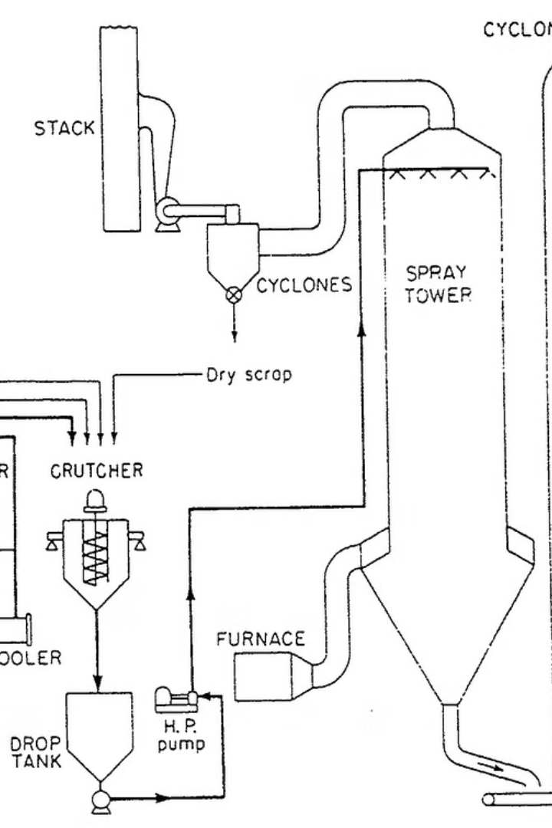
Raw Materials/Production Process
Chloral, a colourless liquid, is first produced by the chlorination of ethanol.
Chlorobenzene, an aromatic compound is then synthesised by the reaction of chloral and benzene in the presence of
Sulfuric Acid.
The final step involves the chlorination of chlorobenzene to produce DDT, which is an off-white crystalline solid.
The crude DDT is then purified through recrystallization or distillation to remove any impurities and obtain the desired technical-grade product. The production process is carefully controlled to ensure consistent quality and yield of the final DDT compound.

Slide 7
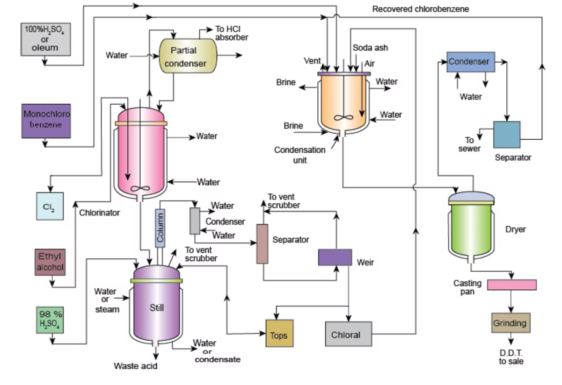
DDT Production Process Flowsheet

Slide 8
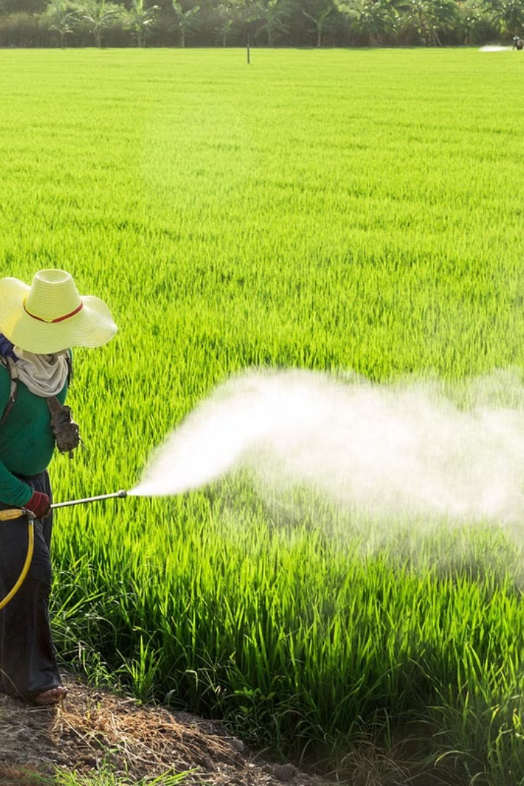
Insecticidal Properties and Mechanism of Action
DDT’s insecticidal properties are primarily derived from its ability to disrupt the normal functioning of the insect's nervous system leading to hyperexcitation, tremors, and ultimately, the death of the insect.
In addition to its direct toxic effects, DDT also has a repellent effect on insects, deterring them from entering treated areas.
This dual mode of action, both insecticidal and repellent, has contributed to the widespread use of DDT in agriculture and public health campaigns targeting various insect-borne diseases, such as malaria and typhus.
The high effectiveness and low cost of DDT have made it a popular choice for insect control, particularly in developing countries.

Slide 9

Agricultural Applications of DDT
DDT was widely adopted in agriculture due to its potent insecticidal properties and effectiveness against a broad range of pests. It proved particularly useful in protecting key food crops such as cotton, corn, and wheat from devastating infestations.
DDT was also extensively used in commercial fruit and vegetable production. It was highly effective against insects that attacked orchard crops like apples, oranges, and grapes, as well as various garden vegetables. This allowed farmers to boost production and improve the quality and appearance of their produce, making it more appealing to consumers.
In addition to direct application on crops, DDT was used to fumigate storage facilities and transportation vehicles. The persistence of DDT also made it useful for long-term protection against pests.

Slide 10
Household and Public Health Applications
Insect Control
Disease Prevention
DDT was extensively used as a household insecticide to control a variety of pests, including mosquitoes, flies, bedbugs, lice, and cockroaches. Its effectiveness in eliminating these disease-carrying insects made it a valuable tool in public health campaigns, particularly in developing countries where malaria and other vector-borne illnesses were major concerns.
Beyond its household use, DDT was also applied in large-scale public health initiatives to control the spread of malaria and other vector-borne diseases. The compound was sprayed in homes, hospitals, and other buildings to kill mosquitoes and other disease-carrying insects, which was instrumental in reducing the incidence of these deadly diseases in many parts of the world.

Slide 11
Environmental Concerns and Regulations
Bioaccumulation
1
DDT's tendency to accumulate in the fatty tissues of living organisms, magnifying up the food chain.
Persistence
2
DDT's long half-life, remaining in the environment for years after application.
Toxicity
3
DDT's harmful effects on wildlife, particularly birds, causing eggshell thinning and population declines.
Regulations
4
The banning of DDT in many countries due to environmental concerns.

Slide 12
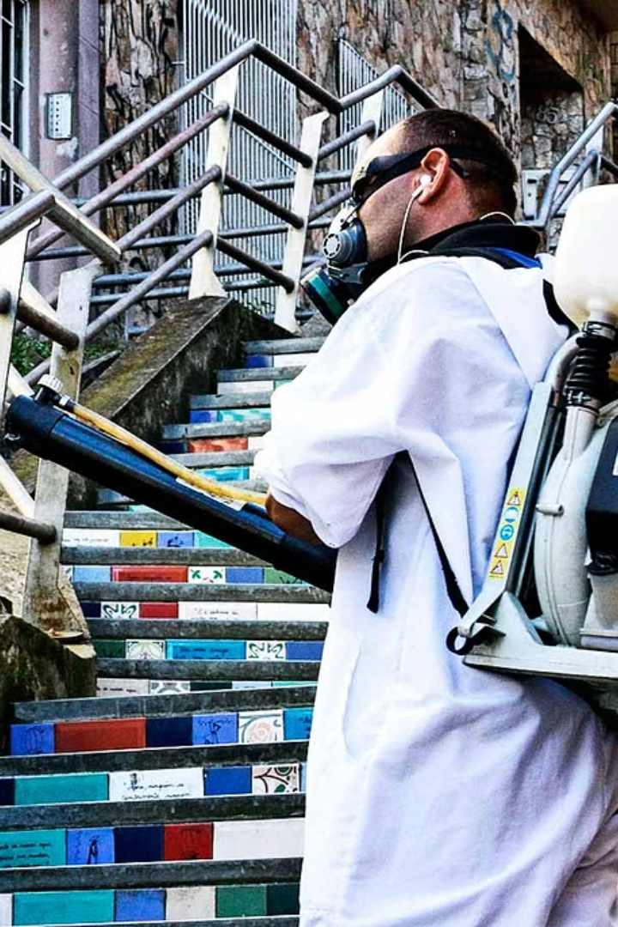
Alternatives to DDT
Researchers have focused on developing alternative insecticides that are more targeted, less persistent in the environment, and pose fewer risks to human health and ecosystems.
pyrethrin, a natural insecticide derived from chrysanthemum flowers. Pyrethrins - less environmentally persistent - lower toxicity to mammals
pyrethroids, such as permethrin and deltamethrin, have also been widely adopted.
Advances in agricultural and public health practices - pests without extensive DDT use.
Microbial insecticide - Bacillus thuringiensis (Bt) and spinosad, have gained popularity. These microbial-based insecticides target specific insect pests while posing minimal risks to humans, wildlife, and the broader environment.

Slide 13
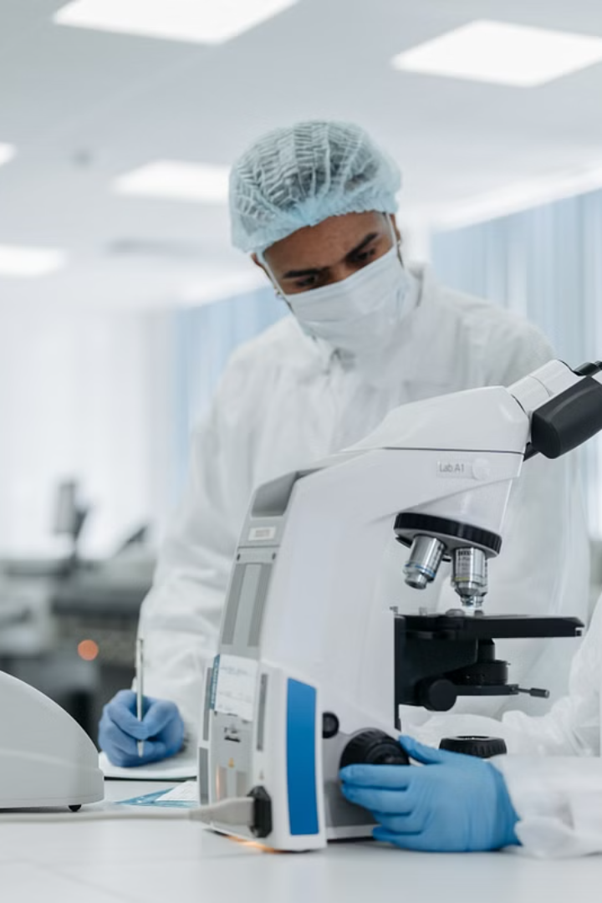
Conclusion and Future Outlook
In conclusion, the discovery and widespread use of DDT have had a profound impact on agriculture, public health, and environmental conservation. While DDT has been highly effective in controlling a range of insect pests and vectors of deadly diseases, its indiscriminate and prolonged use has also led to significant environmental concerns and the eventual ban in many countries.
Looking to the future, the search for alternative insecticides and integrated pest management strategies is an area of active research and development. Newer, more targeted pesticides, as well as biological control methods, offer the potential to effectively manage pests while minimizing the adverse effects on human health and the environment.

Slide 14
References:-
McGRAW-HILL SERIES IN CHEMICAL ENGINEERING, SIDNEY D. KIRKPATRICK
WIKIPEDIA DDT - Wikipedia
Dichlorodiphenyltrichloroethane (DDT) Factsheet | National Biomonitoring Program | CDC
DDT - A Brief History and Status | US EPA

